Slide 1
CMP 839: Programming Fundamentals
Session 1
www.profburnett.com

Slide 2
Session Outline
Part I - Getting Started
  Part I - Chapter 1. Getting Started Programming a Computer
  Part I - Chapter 2. Different Methods for Writing Programs
  Part I - Chapter 3. Types of Programming Languages
  Part I - Chapter 4. Programming Tools
  Part I - Chapter 5. Managing Large Projects with Software Engineering
Part II - Programming Basics
  Part II - Chapter 1. How Programs Work

Slide 3
Chapter 1 - Programming a Computer
Understanding How a Computer Works
History of Programming
Discovering Programming

Slide 4
Understanding How a Computer Works
Problem Solving
Identify the Problem
Define the Steps to Solve the Problem

Slide 5
History of Programming
How Do Computers Talk?
Binary Language = Machine Language
Computer Processor talks Machine Language
Assembly Language
Machine Language
Hardware

Slide 6



Number Base
Hexadecimal (Base 16) | Decimal (Base 10) | Binary (Base 2)
0_{hex} | 0 | 0000
1_{hex} | 1 | 0001
2_{hex} | 2 | 0010
3_{hex} | 3 | 0011
4_{hex} | 4 | 0100
5_{hex} | 5 | 0101
6_{hex} | 6 | 0110
7_{hex} | 7 | 0111
8_{hex} | 8 | 1000
9_{hex} | 9 | 1001
A_{hex} | 10 | 1010
B_{hex} | 11 | 1011
C_{hex} | 12 | 1100
D_{hex} | 13 | 1101
E_{hex} | 14 | 1110
F_{hex} | 15 | 1111

Slide 7
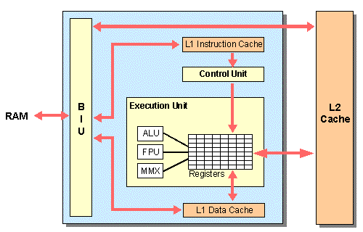
Assembly Language
Make Programming Easier
Assembly Language address CPU Registers

Slide 8
Higher Level Languages
Makes Programming Easier
C Programming Compromise
OO & Visual Language
Fortran
C
Pascal
High Level Language
Assembly Language
Machine Language
Hardware

Slide 9
Language Conversion
Translates Source Code to Machine Code
Assembly Language converted by “Assembler”
High Language converted by “Compiler”
OO & Visual Language
Fortran
C
Pascal
High Level Language
Assembly Language
Machine Language
Hardware

Slide 10
OS & Programming
Windows
  Visual Basic
  Visual C++
  Visual C#
  Visual J++
  Turbo C++
  Turbo C#
  RealBasic
Mac OS X
  C
  C++
  Objective C
  Java
  RealBasic

Slide 11
OS & Programming
Linix
  C
  C++
  Objective C
  FORTRAN
  Java
  Ada
  RealBasic
Java
  NetBeans
  BlueJ
  Eclipse

Slide 12
Discovering Programming
Programming is about Solving a Problem
Programming Principles
Programming Languages Change

Slide 13
Chapter 2 - Methods for Writing Programs
Spaghetti Programming
Structured Programming
Object-Oriented Programming

Slide 14
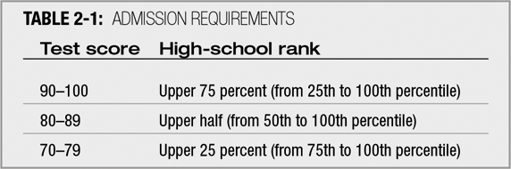
Unstructured Spaghetti Code
Spaghetti code – logically snarled program statements
Can be the result of poor program design
  Example: college admissions criteria

Slide 15
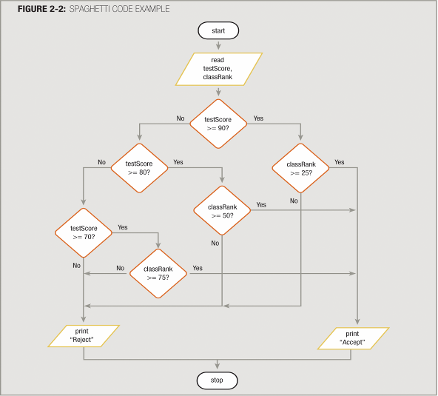
Unstructured Spaghetti Code

Slide 16
Structured Programming
Three Basic Program Structures
Structure: a basic unit of programming logic
Any program can be constructed from only three basic types of structures
  Sequence
  Selection (Branches)
  Loop

Slide 17
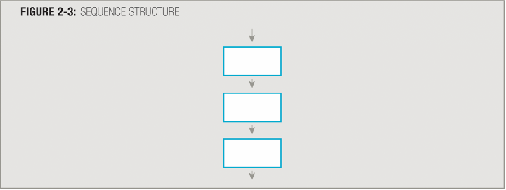
Three Basic Program Structures
Sequence structure
  A set of instructions, performed sequentially with no branching

Slide 18
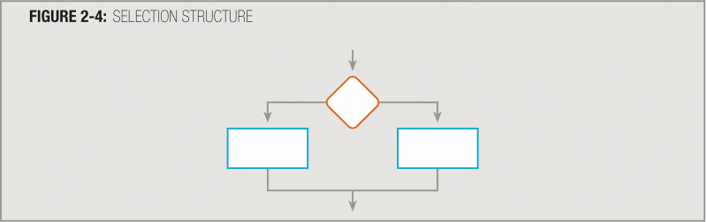
Three Basic Program Structures
Selection structure
  Asks a question, then takes one of two possible courses of action based on the answer
  Also called a decision structure or an if-then-else

Slide 19
Three Basic Program Structures
Dual-alternative if: contains two alternatives

Slide 20
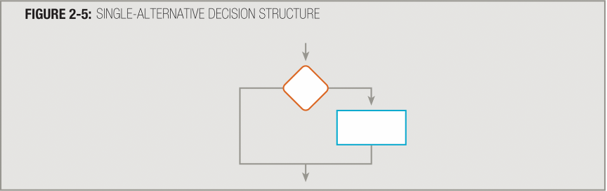
Three Basic Program Structures
Single-alternative if: contains one alternative

Slide 21

Three Basic Program Structures
Single-alternative if
Else clause is not required
Null case: situation where nothing is done

Slide 22
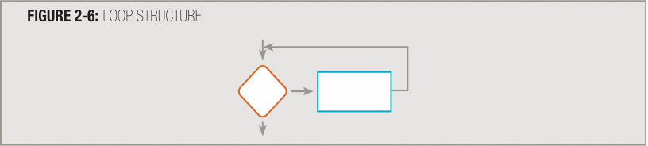
Three Basic Program Structures
Loop structure
  Repeats a set of actions based on the answer to a question
  Also called repetition or iteration
  Question is asked first in the most common form of loop

Slide 23
Three Basic Program Structures
Loop structure

Slide 24
Three Basic Program Structures
All logic problems can be solved using only these three structures
Structures can be combined in an infinite number of ways
Stacking: attaching structures end-to-end
End-structure statements
  Indicate the end of a structure
  endif: ends an if-then-else structure
  endwhile: ends a loop structure

Slide 25
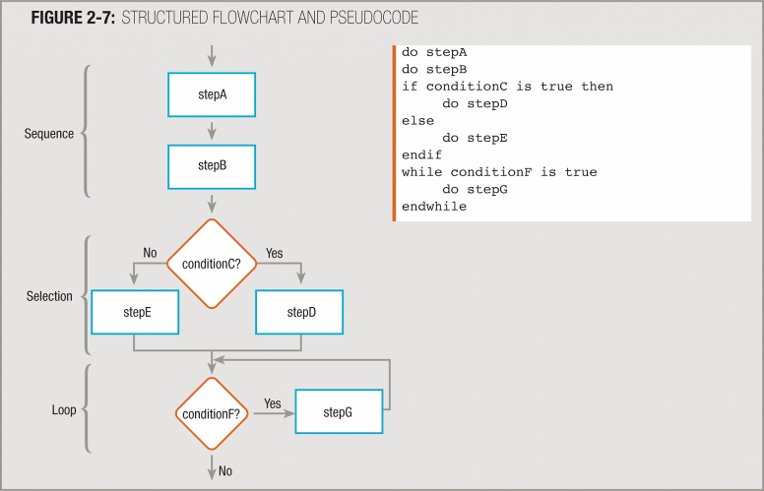
Three Basic Program Structures

Slide 26
Three Basic Program Structures
Any individual task or step in a structure can be replaced by a structure
Nesting: placing one structure within another
Indent the nested structure’s statements
Block: group of statements that execute as a single unit

Slide 27
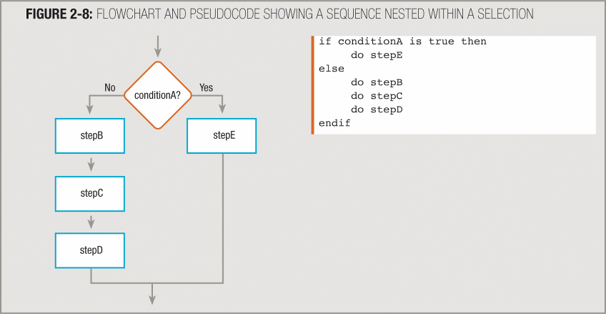
Three Basic Program Structures

Slide 28
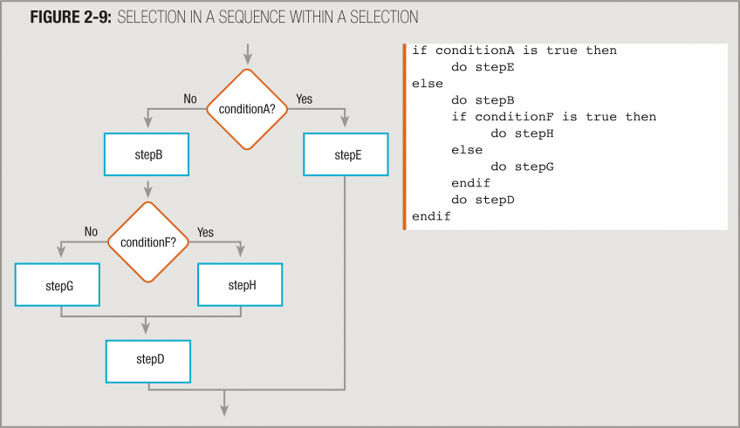
Three Basic Program Structures

Slide 29
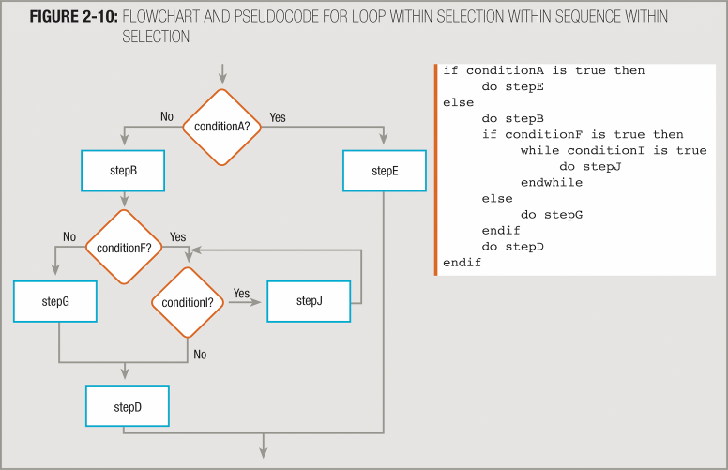
Three Basic Program Structures

Slide 30
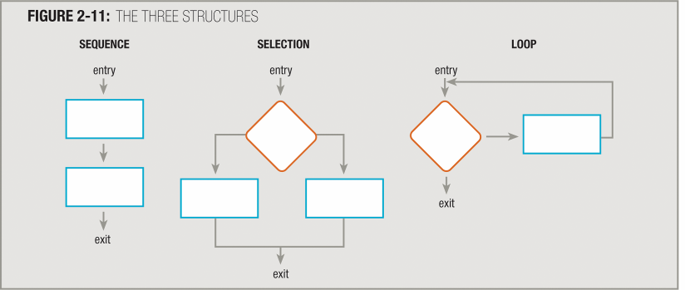
Three Basic Program Structures
Each structure has one entry and one exit point
Structures attach to others only at entry or exit points

Slide 31
Object-Oriented Programming (OOP)
Objects Isolate Data
Objects Simplify Modification
  Code Reusability

Slide 32
Object Oriented Concepts
Data Encapsulation
Inheritance
Polymorphism
Class
Objects
Metadata

Slide 33
Object Characteristics
A particular instance of a class.
  State
  Properties or Attributes
  Methods or Behaviors

Slide 34
Chapter 3 - Types of Programming Languages
Compiled
Curly-bracket
Data-Oriented
Embeddable
Fourth-Generation
Interpreted
Object-Oriented
Scripting
XML

Slide 35
Compiled Programming Languages
C
C++
C#
COBOL
Fortran
Objective C
Pascal
Smalltalk
Visual Basic
Visual FoxPro
Visual Prolog

Slide 36
Curly-Bracket Programming Languages
C
C++
C#
COBOL
ECMAScript
ActionScript
JavaScript
Jscript
Java
Perl
PHP
Windows PoweShell (.NET)

Slide 37
Data-Oriented
dBase
SQL
Visual FoxPro

Slide 38
Embeddable
Server Side
  PHP
  VBScript
  WebDNA
  Perl
  Scala
  Python
  Ruby
Client Side
  ActionScript
  Java
  JavaScript
  ECMAScript
  JScript

Slide 39
Fourth-Generation
IBM Informix 4GL
Oracle Express 4GL
Progress 4GL
SAS
Visual FoxPro

Slide 40
Interpreted
J
JavaScript
Pascal
Perl
PHO
Python
Ruby
VBScript
Windows PowerShell (.NET)

Slide 41
Object-Oriented
ActionScript
C++
C#
ColdFusion
Delphi
ECMAScript
J
Perl 5
PHP
Python
RealBasic
Ruby
Smalltalk
VBScript
Visual FoxPro

Slide 42
Scripting
AppleScript
ColdFusion
ECMAScript
Perl
PHP
Python
Ruby
Smalltalk
VBScript
Windows PowerShell

Slide 43
XML
XAML
Xpath
Xquery
XSLT

Slide 44
.NET Framework
Visual Basic
C#
C++
J++
.NET Framework
(pcode similar to the bytecode intermmediate format of Java)
Executable File

Slide 45
Programming Tools
Flowcharting
Unified Modeling Language (UML)
Compilers
Other Tools

Slide 46






Programming Flowcharts
Symbol | Purpose | Description
 | Flow line | Used to indicate the flow of logic by connecting symbols.
 | Terminal (Stop /Start) | Used to represent start and end of flowchart.
 | Process | Used for arithmetic operations and data-manipulations.
 | Decision | Used to represent the operation in which there are two alternatives, true and false.
 | Document | Used to represent output to a document or device.
 | Data | Used to represent data used in a process.
 | Predefined Process | Used to represent a group of statements performing one processing task.

Slide 47

Programming Flowcharts
Symbol | Purpose | Description
 | On-page Connector | Used to join different flow line.
 | Off-page Connector | Used to connect flowchart portion on different page.
 | Database | Used to represent output or input from a database.
 | Multipage Document | Used to represent multiple output to a document or device.
 | External Data | Used to represent data received from external sources.

Slide 48
Unified Modeling Language (UML)
Use Case Chart
Activity Chart
Sequence Chart
State Chart
Collaboration Chart
Component Chart

Slide 49
Unified Modeling Language (UML)
Use Case Chart
Activity Chart
Sequence Chart
State Chart
Collaboration Chart
Component Chart

Slide 50


Unified Modeling Language (UML)
Symbols
Symbol | Purpose | Description
 | Use Case | Represents a textual specification that is created independently from the diagram.
 | Actor | An actor is a person, group, or system that interacts with the use case.
 | System Boundary | Define the extent of a system, which can include one or more use cases.
 | Class Object | Class represents set of objects having similar responsibilities.
 | Object | Objects are entities that have properties and methods defined.

Slide 51
Chapter 4 - Programming Tools
Compiler Operations
Virtual Machine
Source Code
Source Code
Compiler
Compiler
Machine Code
Bytecode
VM Windows
VM Mac OS X
VM Linux
Scripting Interpreters

Slide 52
Choosing a Compiler
OS
Programming Language
Stability
Longevity

Slide 53
Compilers
Windows – Table 4-1, page 89
Mac OS X – Table 4-2, page 90
Linux – Table 4-3, page 90

Slide 54
Other Programming Tools
Editor
Integrated Development Environment
  Debugger
  File Management
  Profiler
  GUI Designer
Help File Creator
Installer
Disassembler

Slide 55
Chapter 5 - Managing Large Projects with Software Engineering
System Development Life Cycle (SDLC)
Rapid Application Development (RAD)
Joint Application Development (JAD)
Extreme Programming (EP) (Agile Software Development)
Computer Aided Software Engineering (CASE)

Slide 56
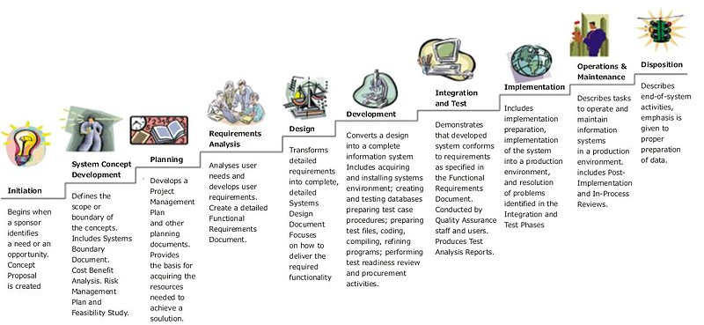
System Development Life Cycle (SDLC)

Slide 57
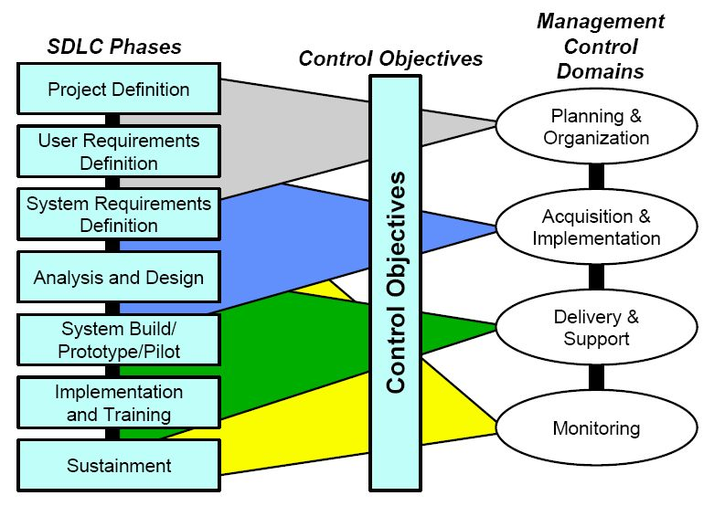
System Development Life Cycle (SDLC)

Slide 58
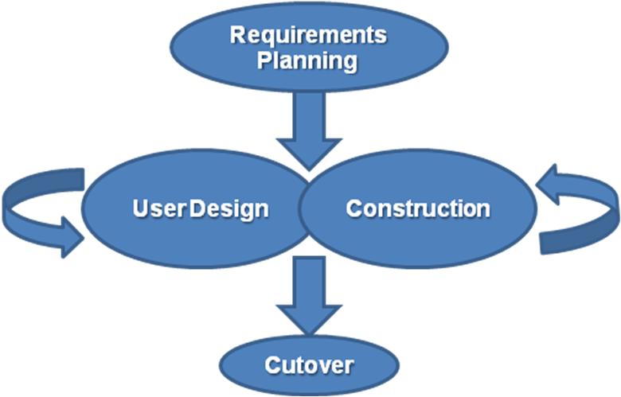
Rapid Application Development (RAD)

Slide 59
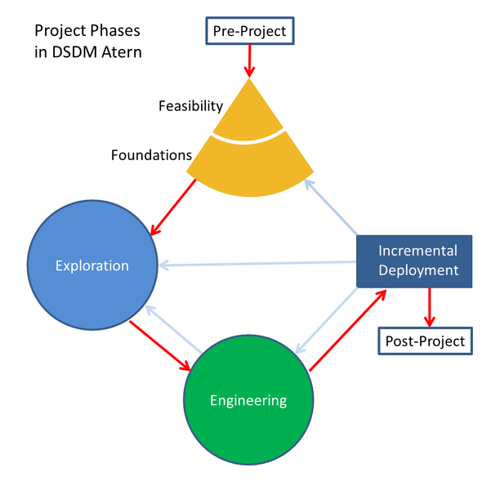
Joint Application Development (JAD)
Dynamic Systems Development Method

Slide 60
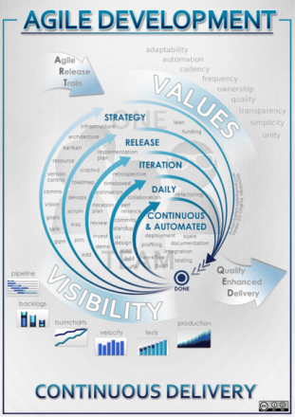
Extreme Programming (EP)
(Agile Software Development)

Slide 61
Computer Aided Software Engineering (CASE)
CASE tool index - Unl.csi.cuny.edu
Unified Modeling Language (UML)

Slide 62
Computer Aided Software Engineering (CASE)
Testbed Setup
  ASP / ISP
  Amazon Web Service
    Amazon EC2
    Amazon S3
Version Control
Private
  CodePlex
  Bitbucket
Open Source
  github
  SourceForge
  Launchpad

Slide 63
Session Review
Part I - Getting Started
  Part I - Chapter 1. Getting Started Programming a Computer
  Part I - Chapter 2. Different Methods for Writing Programs
  Part I - Chapter 3. Types of Programming Languages
  Part I - Chapter 4. Programming Tools
  Part I - Chapter 5. Managing Large Projects with Software Engineering
Next – Programming Basics

